Slide 1

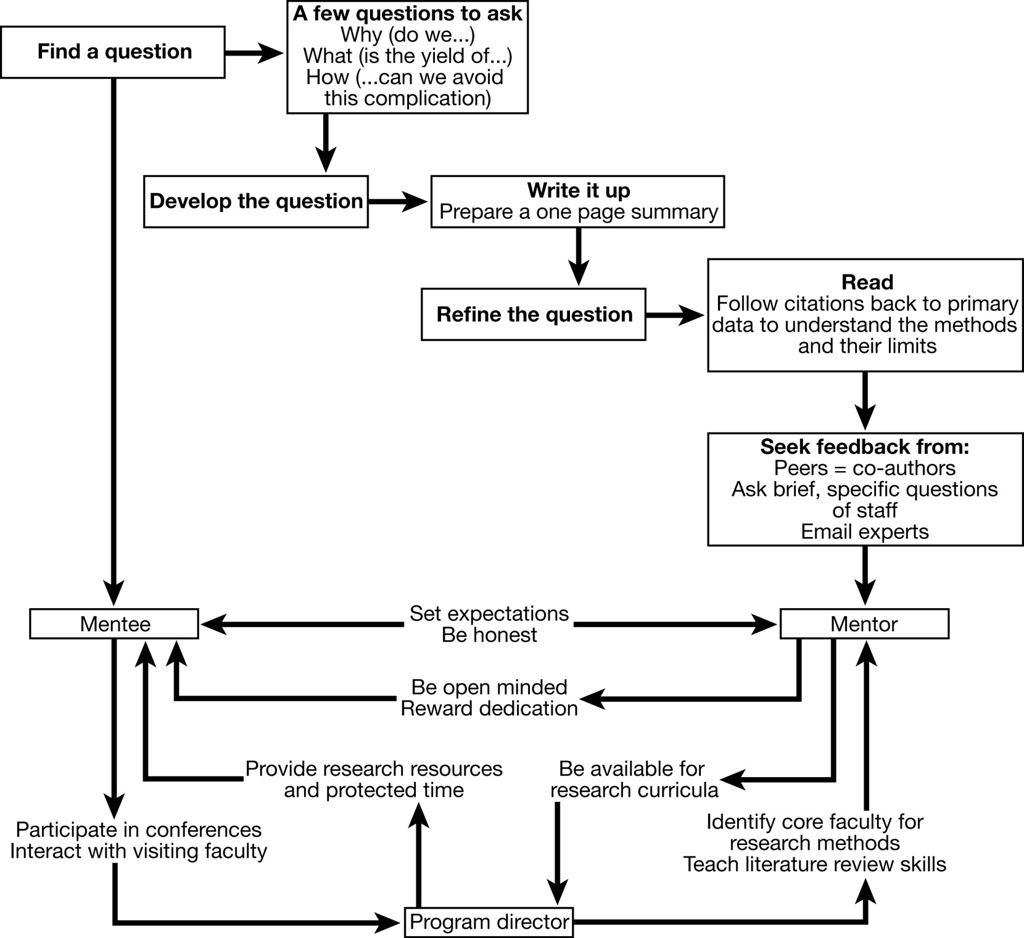
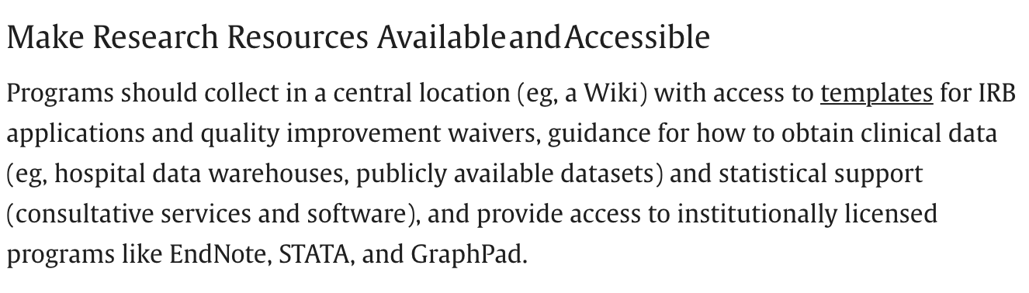
Notes:
Emphasize that you need METHODS mentors (or experts), not SUBJECT mentors.

Slide 2
About me:
Assistant Professor, Clinical Investigation. Intermountain Medical Center.
50% Clinical; Evaluated based on grant success
BS Computer Science & MS Clinical Investigation
Intermountain Early Career Grant: FUND-Hypercapnia
K23 (Career Development Award) pending review at NIH/NHLBI
COI startup MTN [and UU Medical Machine Intelligence Lab] SBIRs pending
Interests:
Hypercapnic Respiratory Failure Clinical Epidemiology and Management
Clinical Reasoning and Didactic Methods
Medical AI and Research Informatics
Notes:
Why do mentors mentor?
Intrinsic:
Training the Next Generation; Improve Medicine; Fun
Incentives:
Clinical Track (majority) – need impact outside of the institution (“excellence”) in 2 of: Clinical Care, Education, Administration, and Research
Tenure Track or similar (minority) – hired (and promoted) to get extra-mural grants: you are helpful to the extent you facility this (publications, preliminary work).
Favors executing previously-conceived projects; has ability/skill
What do you want to get from this? (Everyone wants to graduate)
See if you can make academic research work?
See if you like doing research?
Gain quantitative skills? Writing skills? Reasoning Skills?
[ ] Emphasize differences in TIME to devote to research here

Slide 3
Hypercapnic Respiratory Failure: Overall research premise
inflicts a high burden of disease (prevalence * morbidity)
is becoming a bigger problem (obesity, opiates, multimorbidity)
is (potentially) treatable with NIV, GLP-1Ra, etc.
but the current evidence base is inadequate
is comparatively neglected (biases against this type of patient)
Therefore, doing a better job recognizing hypercapnia will allow:
Better quantification (ie. research) about hypercapnia’s impacts
Better care for patients with known best management.

Slide 4
The deal
Collabs/Mentees
Scarpato
Graham
Darren
Dustin
Alex
Casey Fengerer (PMR)
Somya Mishra (Anesth)
I can:
Guide clinical investigation skillset development
Provide ideas, data, and projects
Help analyze data
Identify resources/data
Matchmake with numerous groups (UU & IMC)
Fund conference travel / pub fees for trainees
I can’t:
Legitimize your grant application or elevate your project at ATS

Slide 5
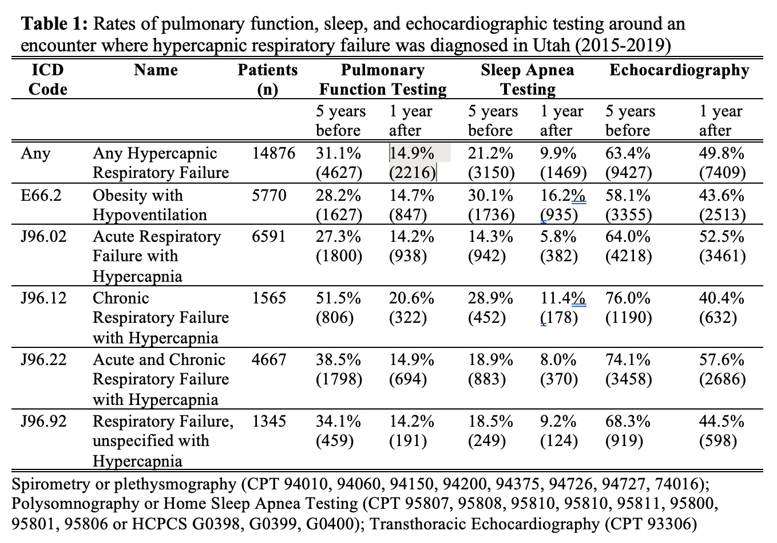
Hypercapnic respiratory failure work-ups
Question: What portion of patients with inpatient hypercapnia have received, or will receive, testing (PFT, TTE, PSG/HSAT) in UT?
Method: Intermountain-UPDB linkage
Status: Pre-research done, Funded, in Regulatory Approval.
Need: Design/Writing/Analysis assistance
Ideal for: interest in epi & chronic resp failure
Team: Ithan Peltan, Sam Brown, Me
Payoff: 2nd author on main paper (High impact pulm), 1st author on spin-offs and conference.

Slide 6
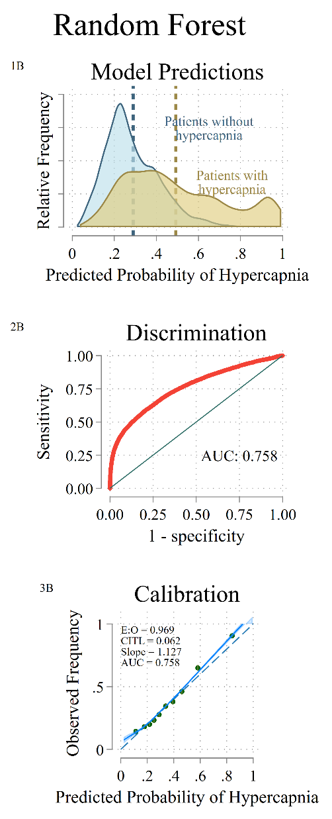
Select-Health ML Project
Aim: Identify Potentially Modifiable Predictors of Utilization in High-Risk Patients, such as hypercapnic RF and others*
Method: IMED-Select Health Linkage; apply machine learning w select patient chars and process measures to predict ED/Admit/ICU
Status: Funded, in regulatory approval
Need: Lead spin-off projects in other dz states.
Ideal for: interest in machine learning, economics
Team: Me, David Hedges (SH), Rylan Fowles (SH), Sam Brown
Payoff: Mid-author in hypercap pub, 1st auth in spinoffs.

Slide 7
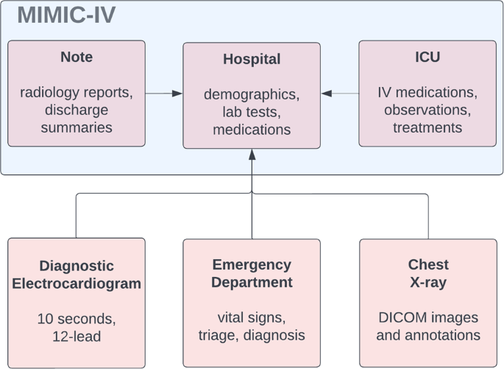
Hypercapnia Presenting Symptoms
Aim: What are the most common chief concerns at presentation for patients identified to have hypercapnic respiratory failure?
Method: Retrospective analysis of MIMIC-IV
Status: Have approval, data access & idea, have not designed/performed analysis.
Need: Fellow to lead design and writing, stats prn
Ideal for: informatics interest, chronic resp failure
Team: Me, Matthias Chirstensen (UU adj), Warren Pettine (Comp Neuro prof)
Payoff: 1st author publication (low-mid tier journal, ?higher as letter)
Notes:
https://m-mi-lab.github.io/about/

Slide 8
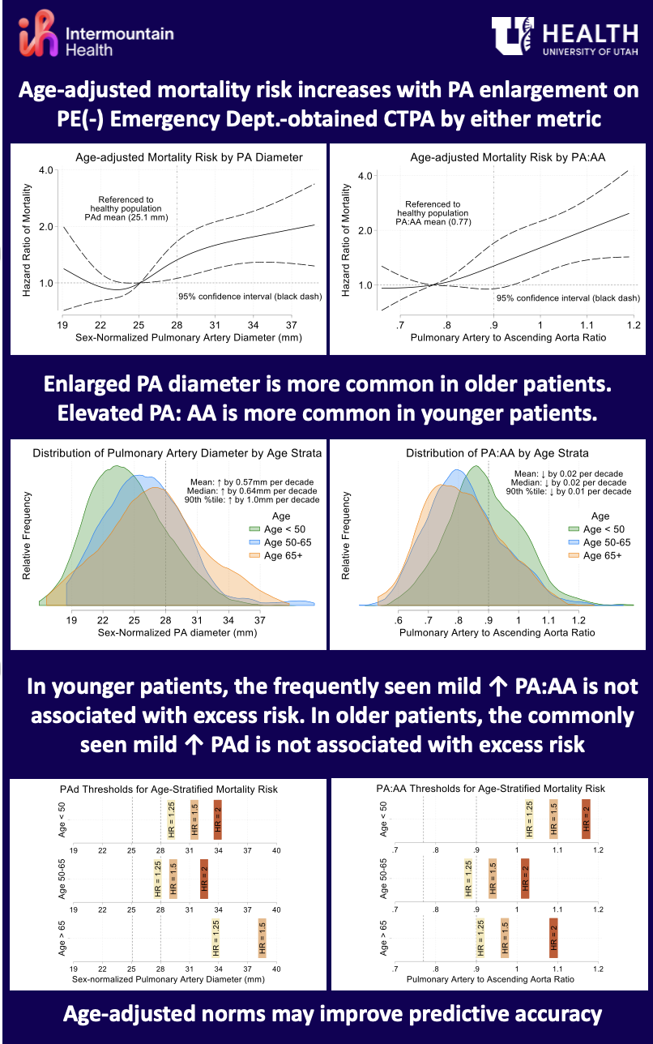
PA Artery Size on CTPA, by Age
Aim: Ascending Aorta (AA) and PA:AA ratio on CT in ED confer excess mortality risk, but thresholds appear age-specific
Method: regression modeling of retrospective review.
Status: data acquired, analyzed, and draft written
Need: a fellow to finish writing/analysis.
Ideal for: quick win, interest in statistical modeling
Team: Scarpato, Me, Dodson
Payoff: 1st author, letter to mid-low tier journal

Slide 9
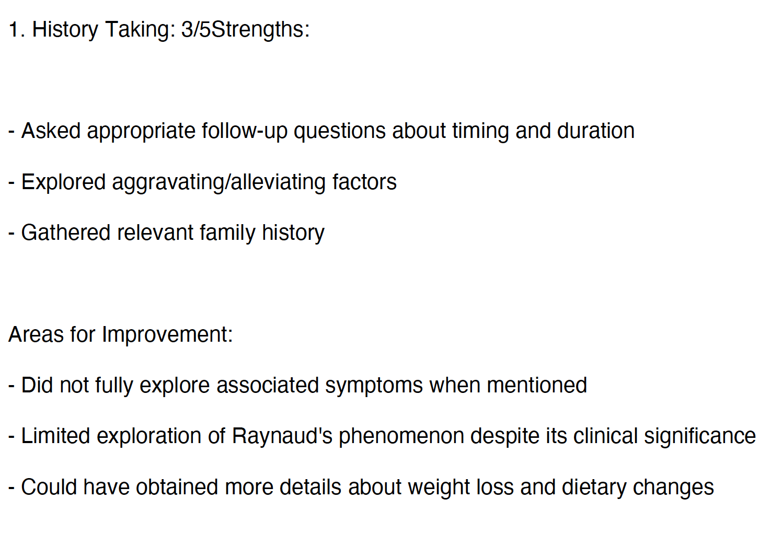
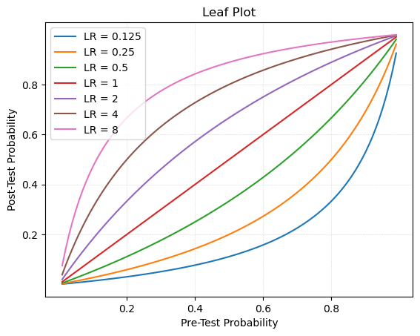
LLMs for Clinical Reasoning Education
Aim: Can LLMs be leveraged to learn and assess progress in diagnostic reasoning?
Method: paired LLM-Chatbot transcripts, with LLM evaluations and educator assessments
Status: Development Beta-testing of product,
Need: Fellow Secondary analyses of data; design
Team: Cory Rohlefsen (Nebraska), & Harvard
Payoff: education publication(s) and credibility from collab w productive group.

Slide 10
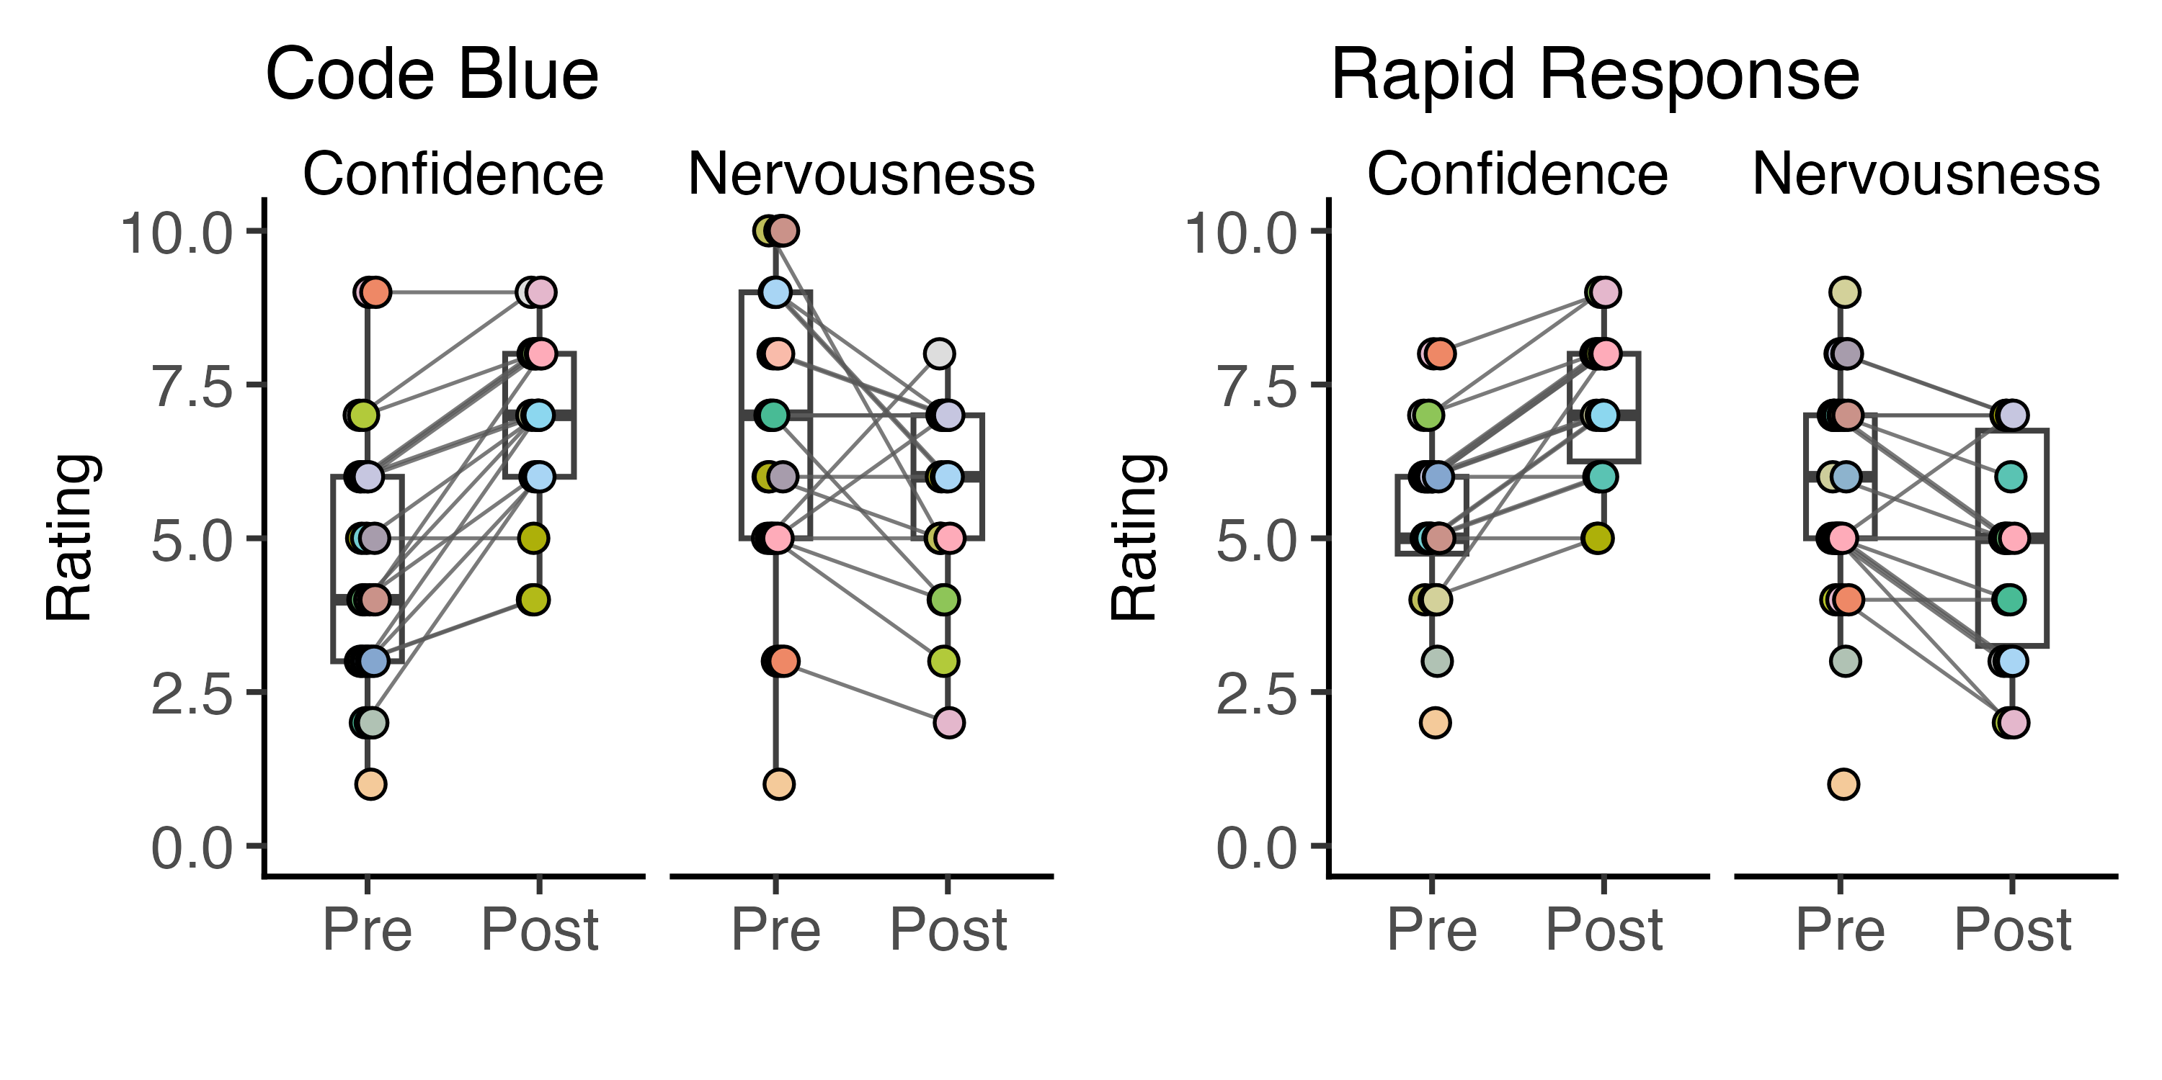
Internal Medicine Education/Seminar(s)
Aim: How can we improve the IM residency P/CCM curriculum?
Method: Delivery and assessment of seminars, e.g. Code Blue
Status: Code Blue in May; Procedures (or replacement next year)?
Need: Interest in Education, curricular design/assessment
Team: Me, Alex(?), IM Chiefs
Payoff: Local ed cred; abstracts/pub prn

Slide 11
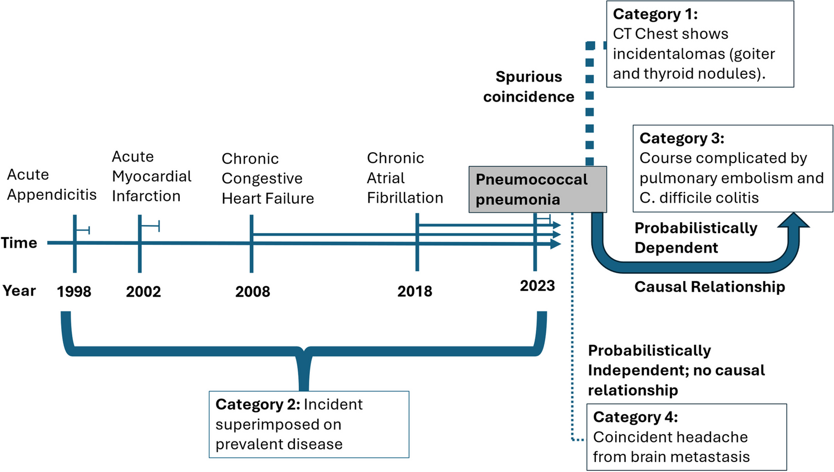
Bayesian Clinical Reasoning
Aim: do clinicians/trainees properly weight the importance of “enabling conditions” in changing the likelihood of diagnoses?
Method: survey, scenarios
Status: idea
Need: fellow champion for writing and design
Team: Me, Scott
Payoff: Gen IM mid tier pub

Slide 12
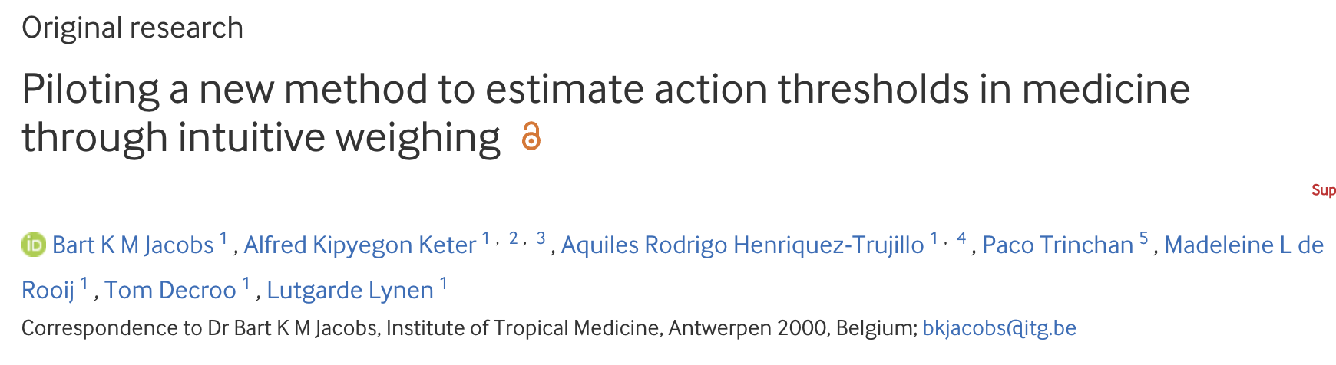
Hypercapnia Diagnostics: Harm of FP vs FN
Problem: Thresholds for any test [e.g. HCO3- level, Modeled Pr(Hypercap)] should be defined to minimize the dis-utility of incorrect results. No evidence exists for hypercapnia diagnosis.
Study Question: How bad is it to miss hypercapnia in comparison to overtesting/overdiagnosing it?
Data: Survey (initially, providers – via Hosp/PCCM/Sleep groups)
Methods: survey
Notes:
https://ebm.bmj.com/content/28/6/392

Slide 13
Hypercap. Diagnosis: ABG vs VBG
Problem: Emergency room providers often use VBGs to “diagnose” hypercapnia, but it’s unclear if they get managed like ABG-diagnosed
Study Question: Do patients admitted with VBGs suggestive of hypercapnia
Receive the same care (ie. ICD-codes of hypercapnic resp failure)
Have the same outcomes (ie. intubation rate, NIV use)
As those with ABGs confirming hypercapnia?
Data: Nationally aggregated EHR (TriNetX) of patients
Methods: Inverse Probability (of A/VBG)-Weighted Comparison
Notes:
What is the course of people who receives VBGs in the emergency department?
*** need data on where the lab was drawn... I think we actually have this.

Slide 14
***What Data Are You Going To Use***
Database work | Chart Review | Meta-research | Survey | Prospective | Basic Science
Do we have access to it now? How much data-cleaning is needed? Can it answer the question? | How big? How long will it take? Can it be used for multiple things? | Systematic Reviews with or without meta-analysis | Who will be surveyed and how will it be done? | Do a feasibility study at most. | ???
Data cleaning is time/expertise intensive | Chart Review is low yield | Time (and team) intensive | Unique methods expertise; limited impact | Inflexible time commitment, mentor dependent
Notes:
CTSI srma core, meta-analysis course,

Slide 15
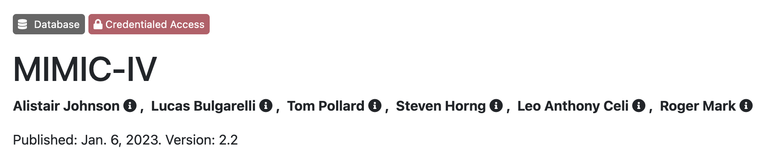
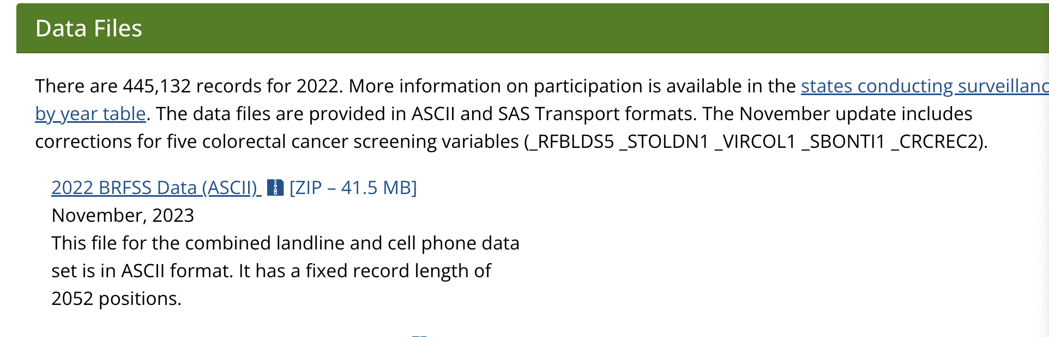

Databases
Health-Record Data
TriNetX -> Ram Gouripeddi
Epic Cosmos -> Vik Deshmukh (IM pays for expedited data requests)
ICU Databases:
Community Cohorts:
Trial Data:

